Slide 1

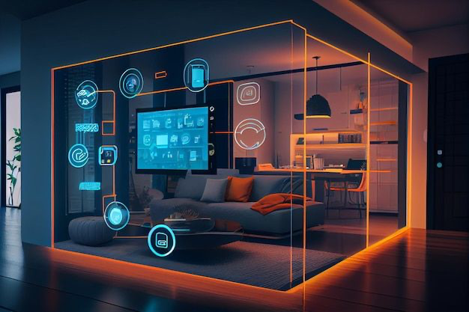




IOT BASED
SMART ROOM
"A smart room isn't just a living space; it's a responsive, intelligent
environment that enhances comfort and convenience through
seamless technology integration."

Slide 2


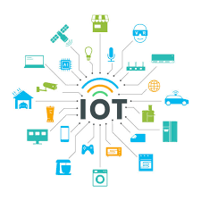



WHAT IS IOT?
IoT, or the Internet of Things, connects everyday objects to the internet for communication and data exchange.
It enables devices to collect, share, and analyze data in real-time.
IoT allows for automation and smart control of various systems and devices
It integrates technology into our daily lives, enhancing convenience and efficiency.

Slide 3

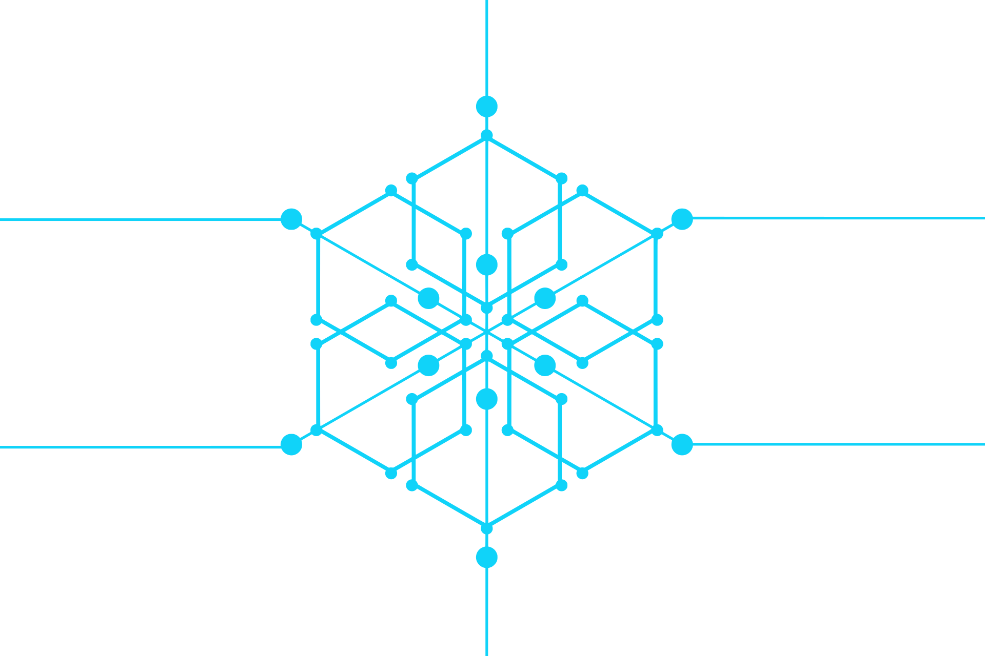



Smart Room Benefits
Safety & Security
Real-time monitoring and instant alerts to enhance protection against threats.
Seamless Connectivity
Connects devices smoothly, allowing them to work together effortlessly
Comprehensive Automation
IoT automates tasks based on data and preferences, simplifying everyday routines.

Slide 4


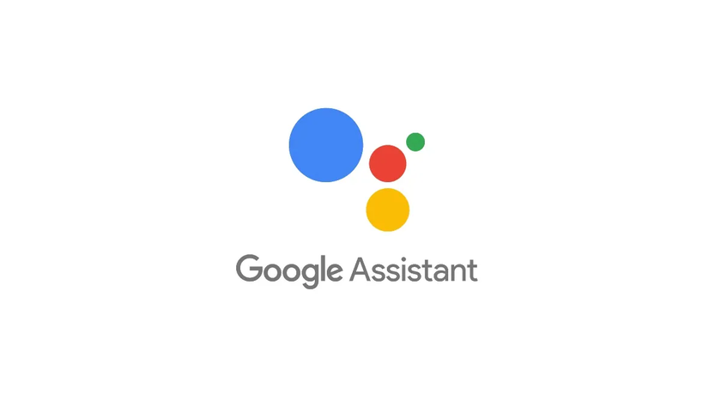




Tech Stack
Arduino IDE
Speech Recognition
Google Firebase
React.js
CSS
Node.js

Slide 5



Components
01.
ESP32/
ESP8266
Casing
06.
Sensors
02.
Mobile/
Laptop
Actuators
05.
03.
Smart Devices
04.

Slide 6

Features
Voice-Controlled
Automation
Real-Time
Monitoring
Motion Detection
Energy Efficiency
Optimization
Easily control lighting, climate, and security through hands-free voice commands.
Monitor environmental conditions and device statuses in real-time via a centralized dashboard.
Motion detection uses sensors to detect movement and trigger automated actions like turning on lights or activating security systems.
Automate and adjust energy usage based on occupancy and environmental data to reduce costs

Slide 7
Implementation
01.
02
03
04
Hardware Setup
Software
Development
Platform
Integration
Testing &
Optimisation

Slide 8

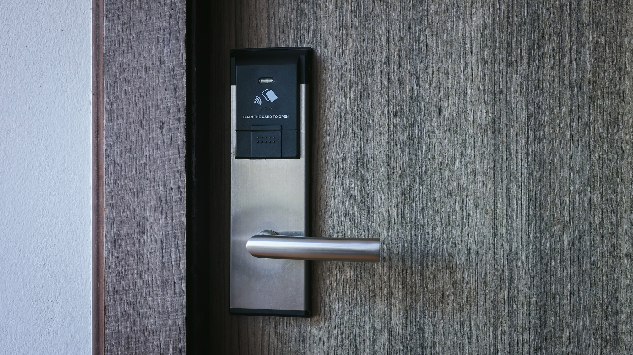
Real Life Applications
Smart Home Automation: Use IoT to automate lighting, climate control, and security, creating a more comfortable and energy-efficient living environment.
Elderly Care Monitoring: Implement IoT sensors and voice assistants to monitor health and safety, providing real-time alerts and assistance for elderly individuals living independently.

Slide 9





THANK YOU!
9958728538
Ashu2100ag@gmail.com
https://github.com/CodeBeginner000001

